Slide 1
Capstone
Draft tonight (I’ll review over the next 5 days)
Final presentations and report due on 12/11
Presentations 7 pm 12/11 in HLS 366
10 minutes per team
Don’t mess up on the timing!
Practice!
Make it educational and fun for your classmates!

Slide 2
You conquered snakes, spiders, other worlds in the transition to Jupyter
You took on the challenge of Jupyter notebooks and you excelled!
You demonstrated your ability to learn with minimal guidance
You are a great class! Thank you!
Juan, Cynthia, and Zoe are amazing people and outstanding teachers

Slide 3
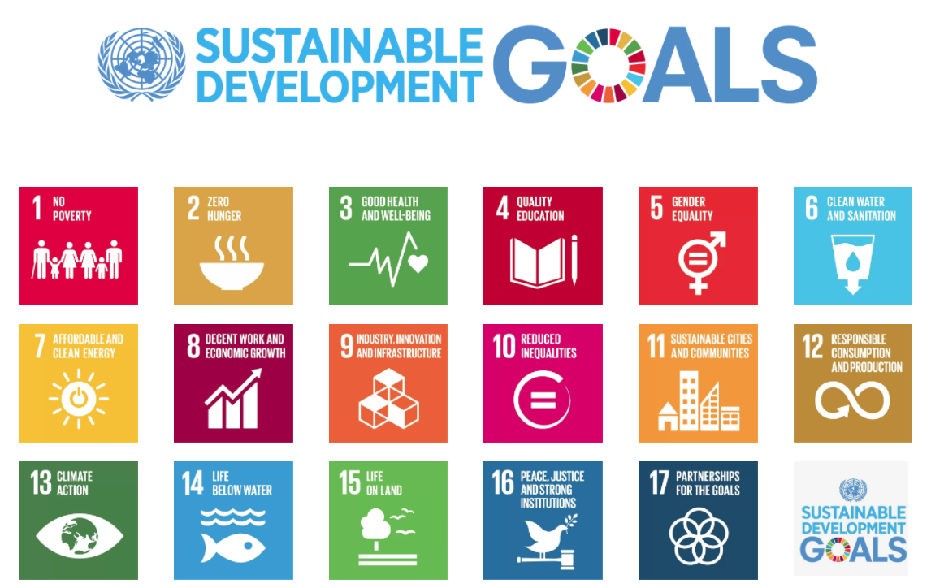
2015 to 2030
Notes:
On 1 January 2016, the 17 Sustainable Development Goals (SDGs) of the 2030 Agenda for Sustainable Development — adopted by world leaders in September 2015 at an historic UN Summit — officially came into force. Over the next fifteen years, with these new Goals that universally apply to all, countries will mobilize efforts to end all forms of poverty, fight inequalities and tackle climate change, while ensuring that no one is left behind.
http://www.un.org/sustainabledevelopment/development-agenda/

Slide 4

At least 1.8 billion people use a source of drinking water contaminated with feces
More than 80% of wastewater is discharged without any pollution removal

Slide 5
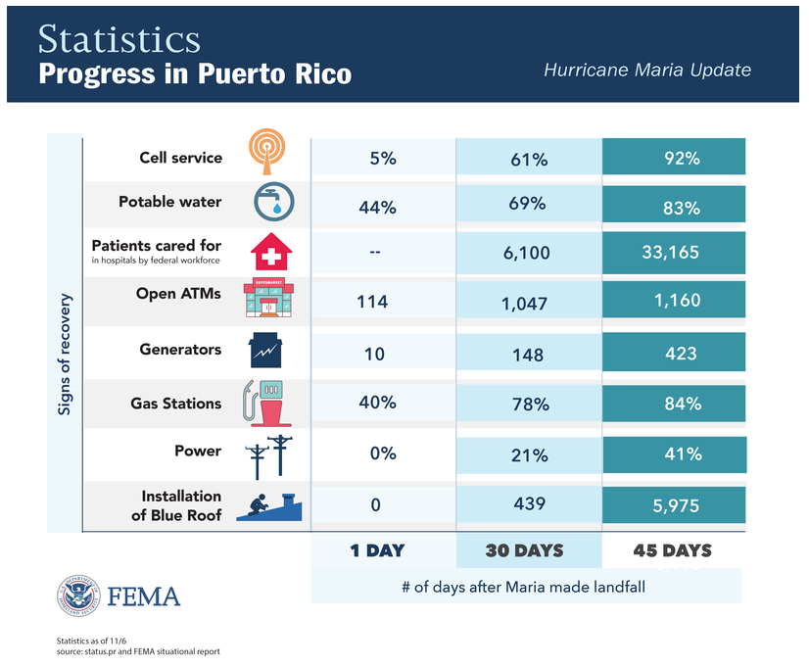
Notes:
https://www.fema.gov/hurricane-maria

Slide 6

SDG 6.1: By 2030, safe and affordable drinking water for all
Some three in ten people (2.3 billion) lack access to safe and readily available water at home
Additional 1.2 billion from population growth gives 3.5 billion need water by 2030
267 million people per year! (1 Indonesia/year)
At 3 mL/s per person we need 800,000 L/s per year of new installed capacity
Notes:
http://www.un.org/sustainabledevelopment/blog/2017/07/billions-around-the-world-lack-safe-water-proper-sanitation-facilities-reveals-un-report/

Slide 7
US Water Infrastructure
ASCE Infrastructure Grade is D+
What you’ve learned in this course is completely applicable to designing new and upgrading existing water treatment infrastructure anywhere on this planet
US water treatment infrastructure is far from optimally designed
Most sedimentation tanks don’t even have floc blankets!

Slide 8
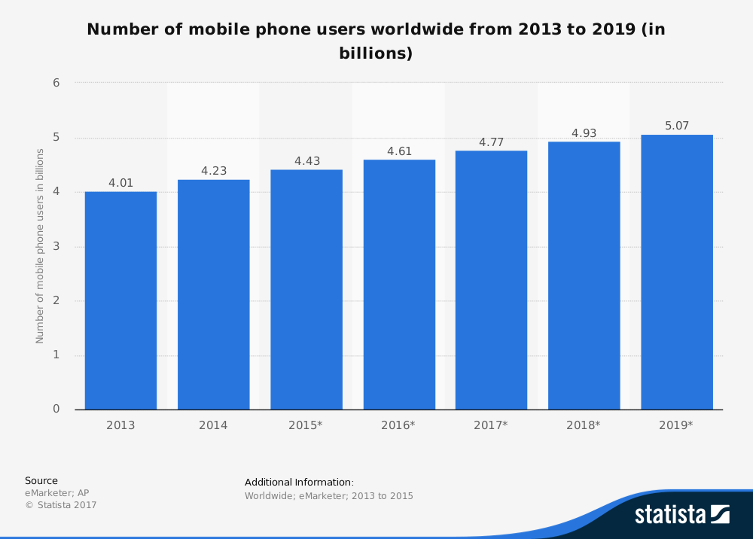
One billion new cell phone users in 6 years!
Notes:
eMarketer, & AP. (n.d.). Number of mobile phone users worldwide from 2013 to 2019 (in billions). In Statista - The Statistics Portal. Retrieved November 11, 2017, from https://www.statista.com/statistics/274774/forecast-of-mobile-phone-users-worldwide/.

Slide 9
Mobile phones and safe water in Honduras
mobile phone
safe water on tap
8.63% of income
$15.66 per month
90% of the population has a cell phone
1.1% of income
$1 per month O&M
$1 for capital costs
Perhaps 50%? (no good data)
Lack of a mechanism to recover capital cost is one impediment to the spread of safe water on tap.
Notes:
http://blogs.worldbank.org/opendata/where-are-cheapest-and-most-expensive-countries-own-mobile-phone
https://www.budde.com.au/Research/Honduras-Telecoms-Mobile-Broadband-and-Digital-Media-Statistics-and-Analyses

Slide 10
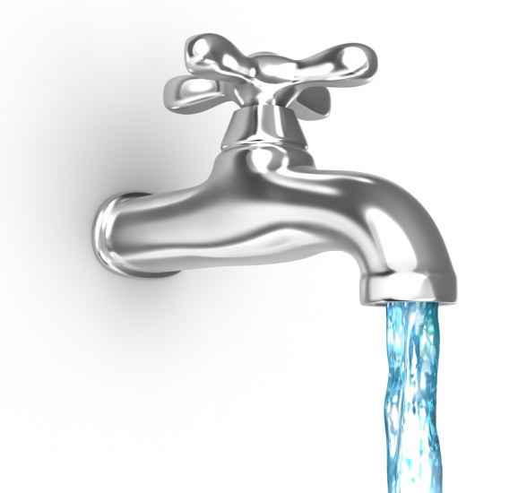
The proven strategy in early industrialized countries is
Centralized (community scale) water treatment
Distribution system that brings safe water to each household
Safe water on tap

Slide 11
Why don’t countries prioritize building water supply systems and drinking water treatment plants?
Notes:
Maybe they are making a rational decision!
If investing in drinking water supply seems to only result in more problems, then why bother?

Slide 12
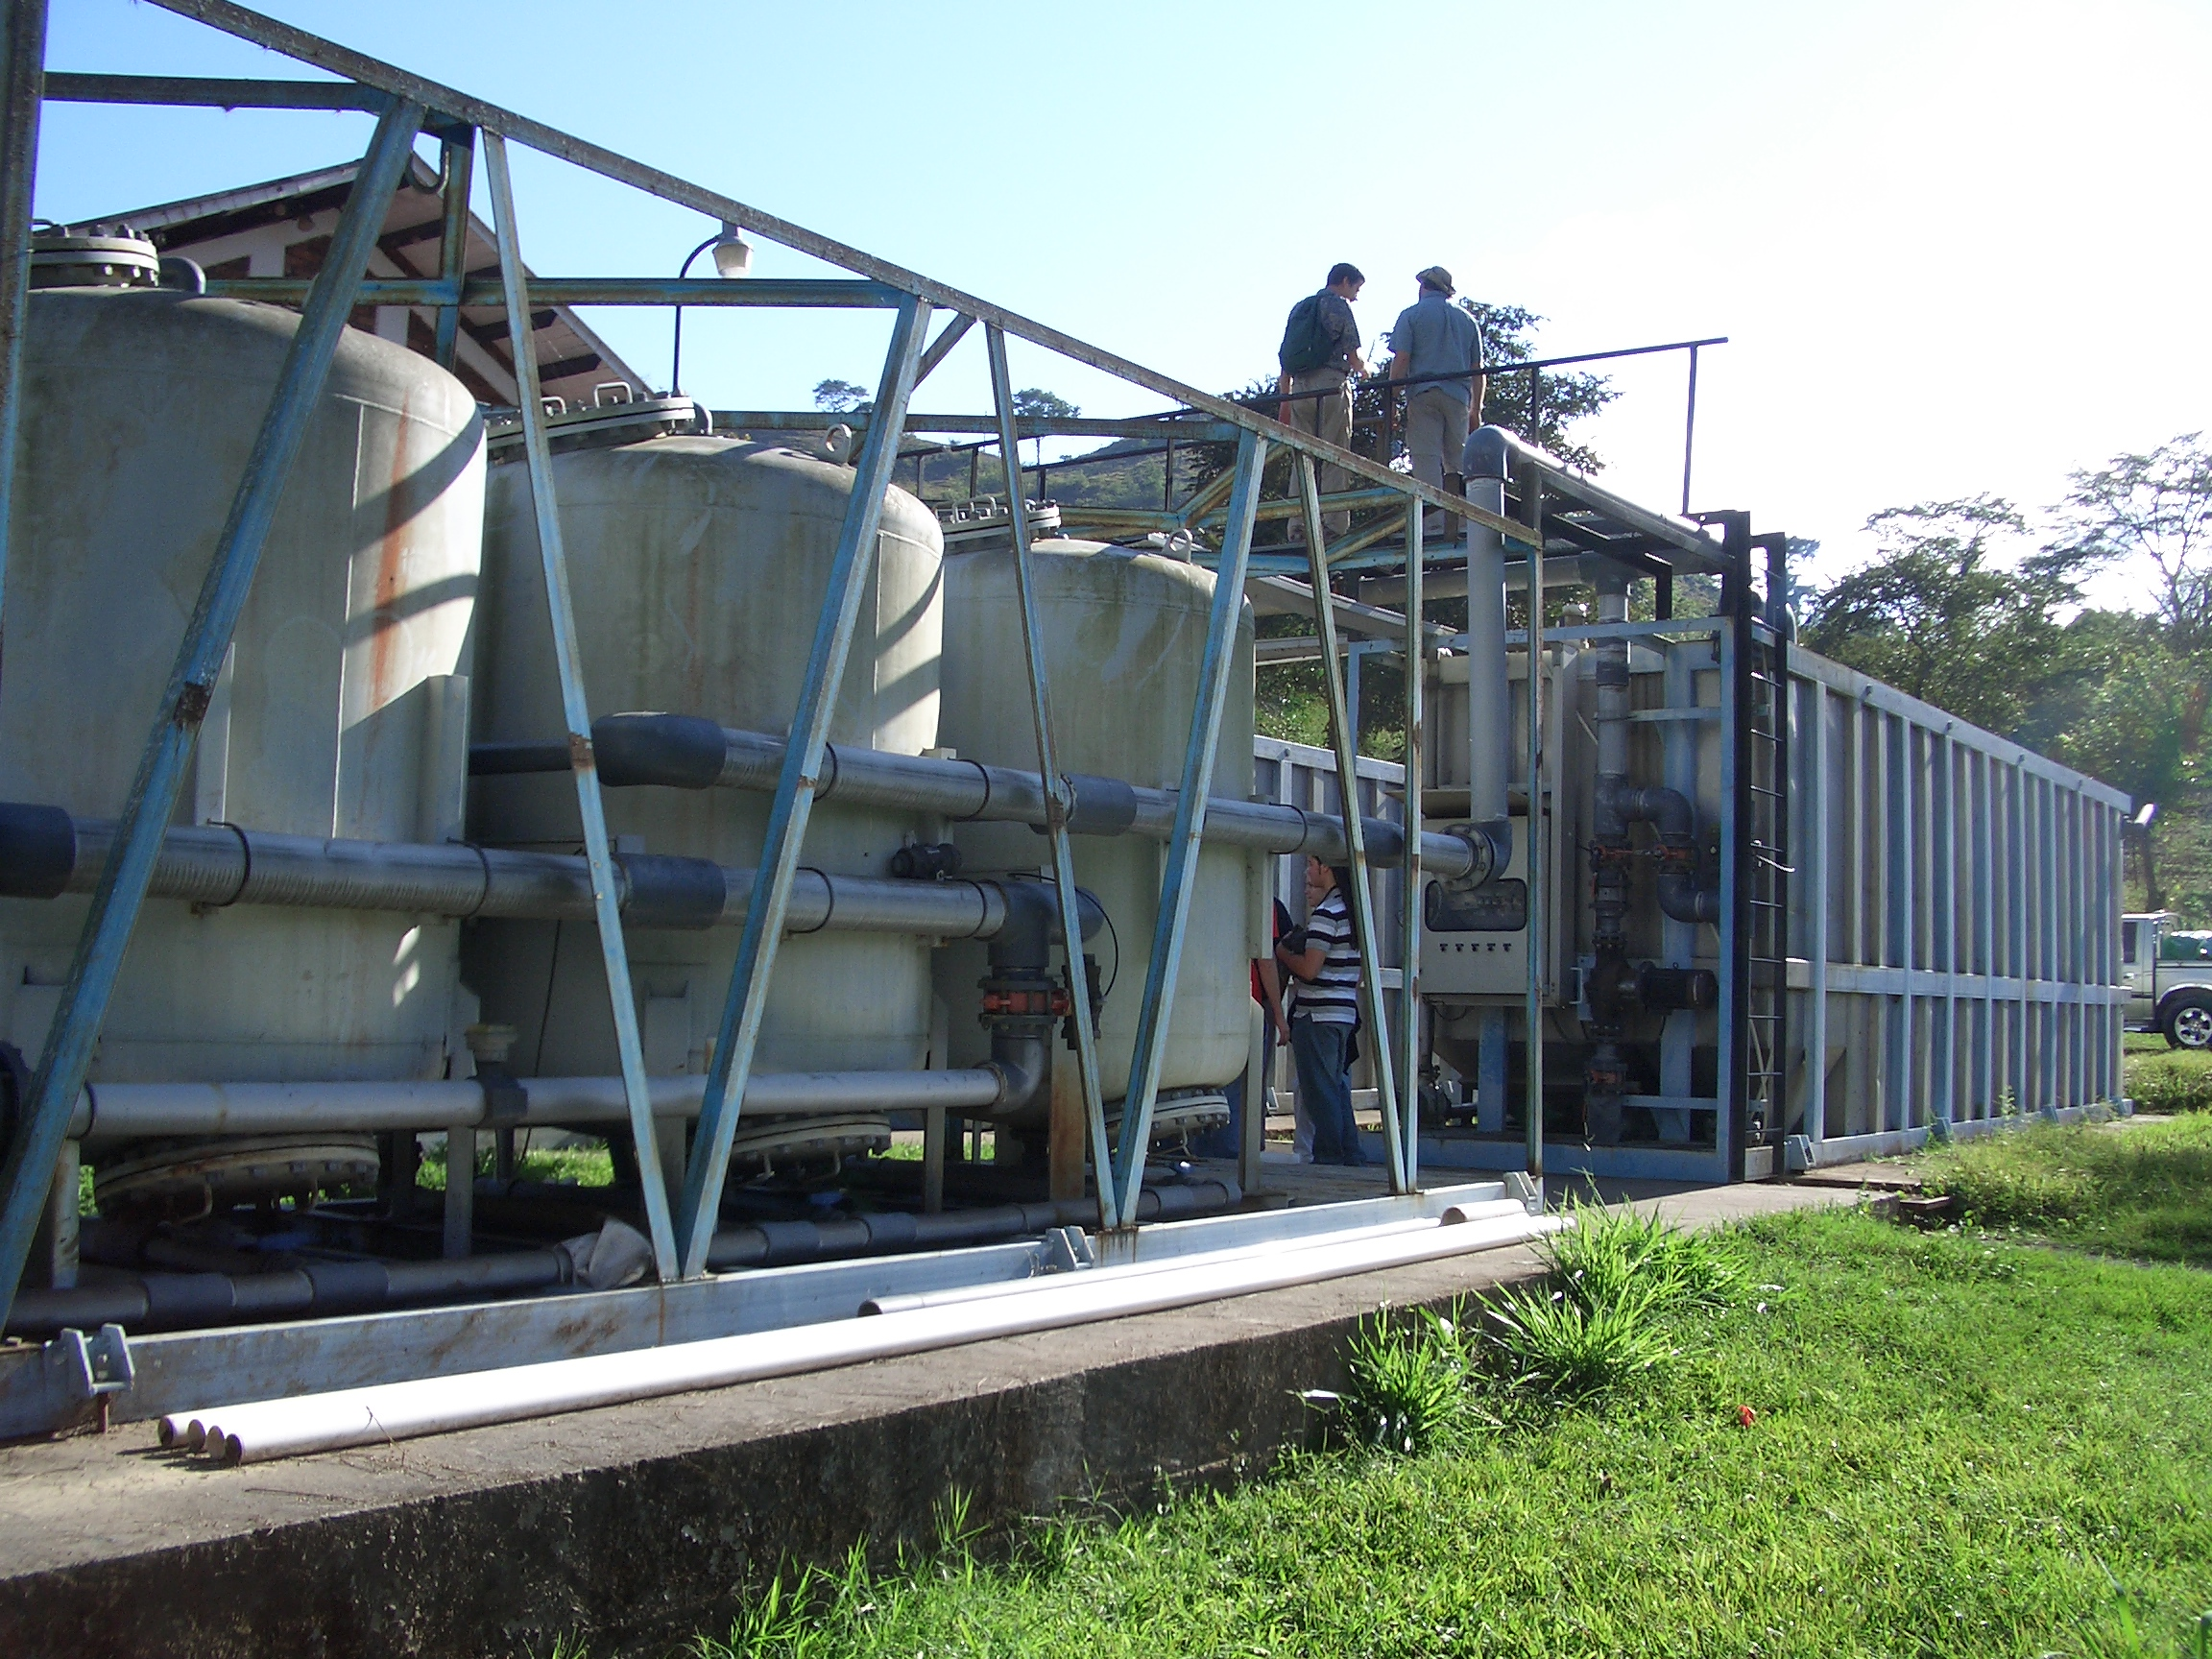
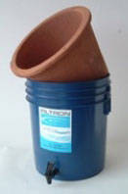
Traditional solutions aren’t performing well in the Global South
Decentralized – household and Kiosk
Centralized – Municipal scale
“advanced technologies”
Don’t provide water access
No monitoring
Require every household to invest time in maintenance and operation
High part count = high failure rate
High capital and maintenance costs
High energy use
Poor water quality

Slide 13
Centralized water has a bad reputation!
“…relying only on time- and resource-intensive centralized solutions such as piped, treated water will leave hundreds of millions of people without safe water far into the future.
Self-sustaining, decentralized approaches to making drinking water safe, including point-of-use chemical and solar disinfection, safe water storage, and behavioral change, have been widely field-tested.”
Eric MintzMD, MPH, , Jamie BartramPhD, , Peter LocheryMSc(Eng), and , Martin WegelinMSc
Notes:
http://ajph.aphapublications.org/doi/abs/10.2105/AJPH.91.10.1565

Slide 14
High Tech Package Plant
Notes:
What was the constraint used to create this design????

Slide 15
Centralized water treatment has often failed in the global south
Frequent failures due to high component count
Short life of water treatment infrastructure
20 years for high tech plant in Nicaragua
About 10 years for high tech plants in Honduras
3 years for high tech plants in Africa (World Bank experience)
So if you were a politician would you want to invest in water treatment plants?

Slide 16
Centralized treatment CAN work if we adopt a new approach!
Engineering that focuses on economics, energy, equality, elegance, and efficacy
Low cost is possible
$12 per year per person for operation and maintenance
$50 per person for capital costs
3.5 billion need water - $175 billion capital cost by 2030 ($13.5 billion/year)
Similar to US ice cream purchases
Centralized can be monitored for safety

Slide 17
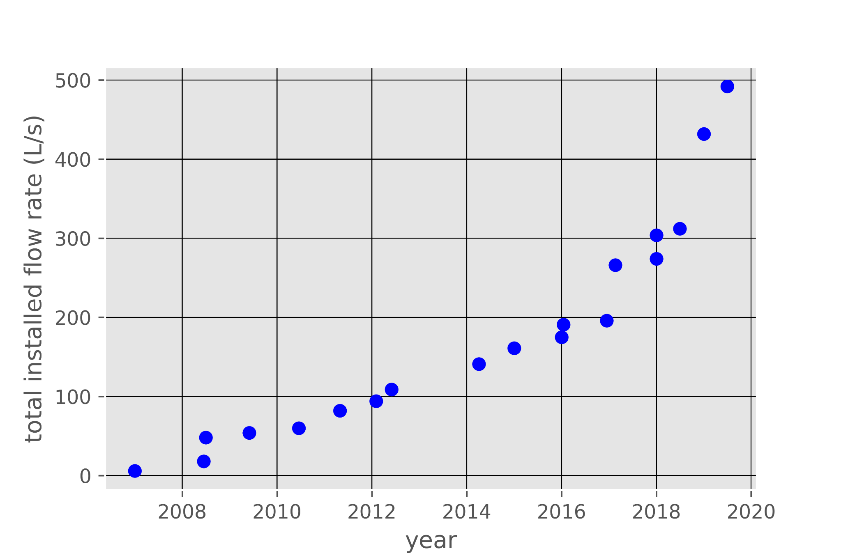
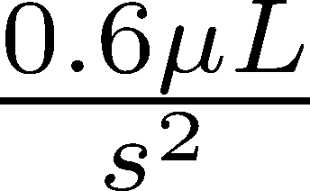
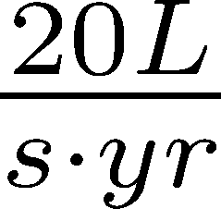
AguaClara installed capacity is increasing steadily (and slowly)

Slide 18
Time for acceleration
We need 800,000 L/s per year of new installed capacity
AguaClara = 20 L/s per year – need to increase rate by a factor of 40,000
Disruptive technologies must be at least twice as good as traditional technologies
Our ongoing research to improve water treatment technologies is critical to increase the rate
Open source engineering is also a disruptive new approach to spreading technologies

Slide 19
The transition is underway with a significant increase in rate!
Ocotal
Gracias
San Rafael del Norte
Zamorano
La Concordia
Las Vegas

Slide 20
Course Reflections?
What is one thing that you learned in this course that you want to always remember?

Slide 21
Challenges on the horizon
Standard designs for flow rates from 1 to 240 L/s
Retrofit designs for larger flat bottom sed tanks (take the case of 10 m square tanks)
Wide range of water contaminants (expand to fluoride, arsenic, wastewater, reuse)
Biggest challenge of all – create enough momentum so that new technologies are adopted and sustained

Slide 22
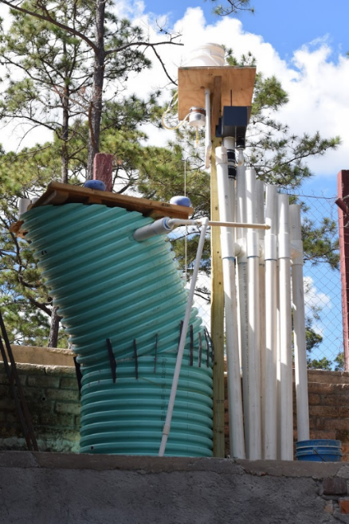
New Opportunities
Million village challenge
Possibly adapted to remove arsenic and fluoride
Demonstrate new technologies at far lower cost ($10k rather than $100+k)

Slide 23
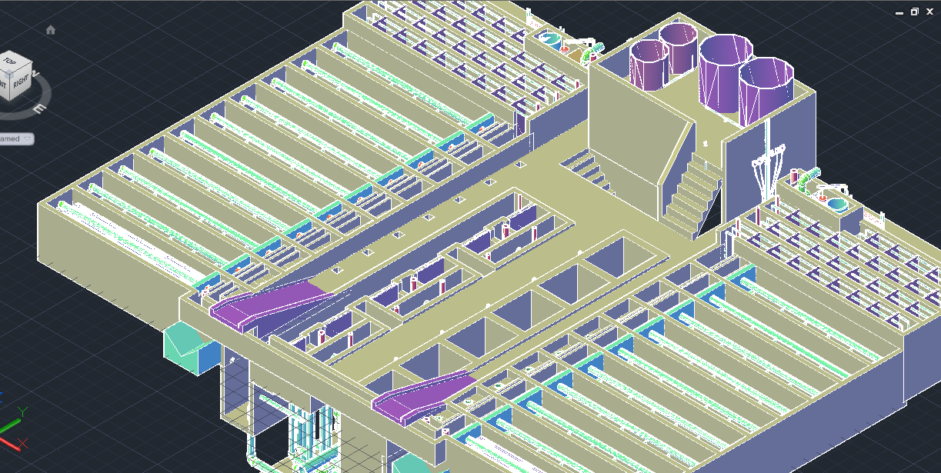
120 L/s AguaClara plant (draft design for Gracias, Honduras)
Meghan Furton M.Eng. 2017

Slide 24
Connecting Meaning to Graduate School and Professional Careers
Four steps toward a better world
Measure stuff (often sufficient for a Ph.D.)
Create models of how our universe works (based on observations) (fundamental science)
Invent new solutions based on good models of how our universe works (inventing!)
Engage with the world to implement those solutions (engineering!)
Our planet needs bold engineers and scientists who engage to create a better world
Notes:
You can get a Ph.D. doing step 1 sometimes.
Step 2 is great for getting a Ph.D.
Steps 3 and 4 are much harder!

Slide 25
M.Eng. in Environmental and Water Resource Engineering
“The Cornell Masters of Engineering program is one of our top recruiting locations. The students are well prepared due to the technical knowledge and analytical problem-solving capabilities which they learn. But it’s the self-motivation, oral & written communication skills, team-building and leadership skills which they learn that make them excellent consultants and allow them to quickly progress within our organization. Additionally, those involved with the AguaClara program have a passion for improving quality of life which is essential for being a successful environmental engineer.”
-VP at Global Engineering Consulting Firm
Application due date is January 5

Slide 26
AguaClara Project Teams
Excellent opportunity to take what you learned in this course and Research, Invent, Design, and Engage

Slide 27
Internships
REU at Cornell
Recruiting research team leaders
Fluoride removal reactor
AguaClara Engineer Interns

Slide 28
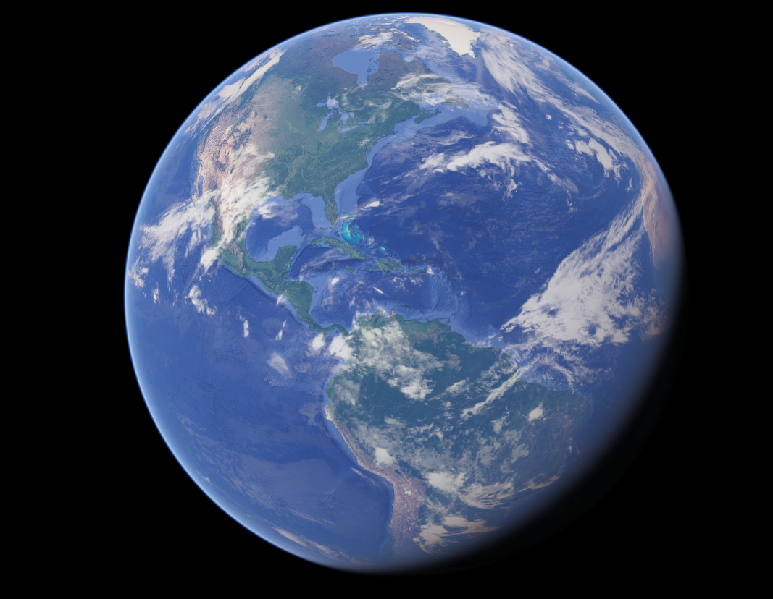
Engineering is Love

